Slide 1












Group
Project
SECURITY SYSYTEM

Slide 2







Contents
01
Introduction
04
photo
02
Explanation
05
video
03
Stages

Slide 3



Introduction
in this report we will go to illustrate security system in several stages

Slide 4
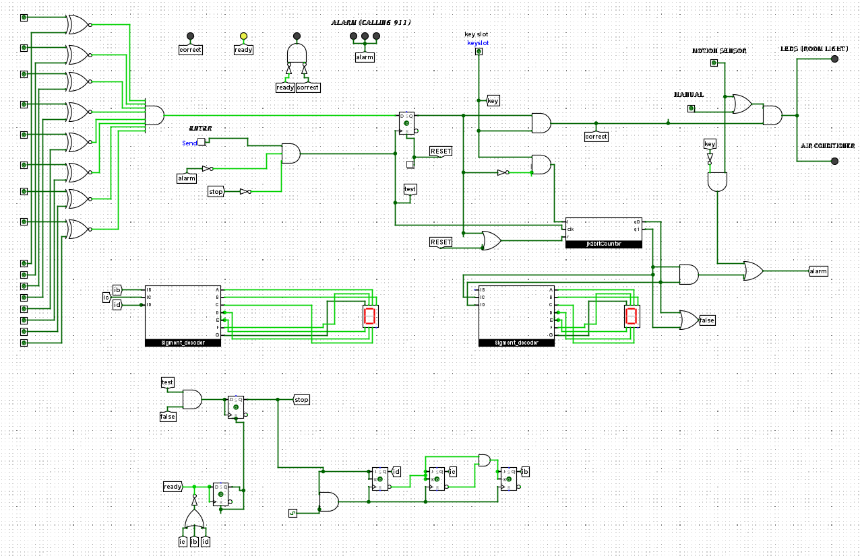
project overview

Slide 5
Stages
Stage 1
Stage 3
Stage 2
check availability of password
indicator and inner system
counter

Slide 6
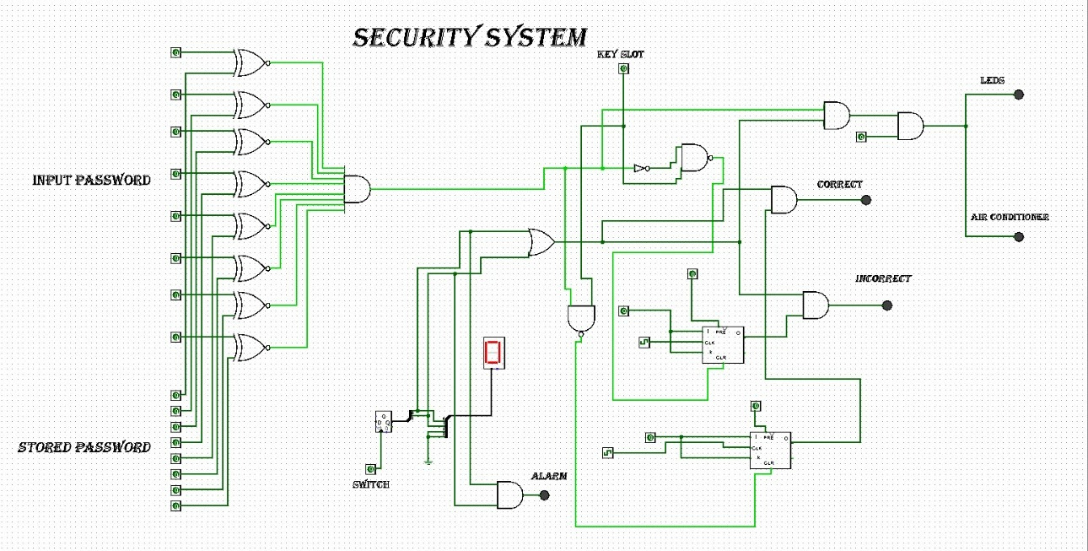
Stage 1
password checker using XNORS,so if the inputs are the same thre output will be one else the output will be zero ,this was the idea that we built our project on ,so if all output are ones And gate will be 1 ,else Zero

Slide 7
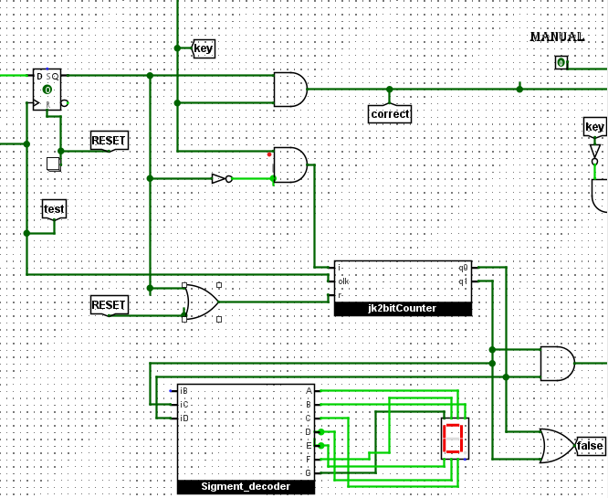

Stage 2
if input is true ,OR gate output is 1& counter is reseted ,if input is false ,output of the And gate is 1 , counter begins and count up to 7 ,(Hint ) counter doesn’t work until press on enter button ,

Slide 8
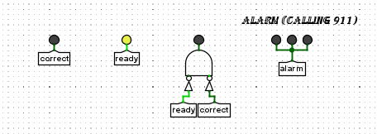
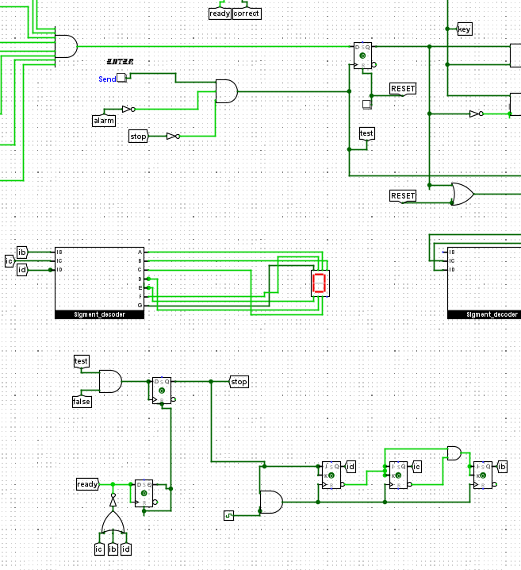
Stage 3
if test is true,and passsword is false ,stop become 1 ,counter begins from 7 until it reaches zero , so NOR output become 1,output of flip flop is 1
ready led turns on and
reset upper D-flipflop and stop become 0,so, it reset counter

Slide 9
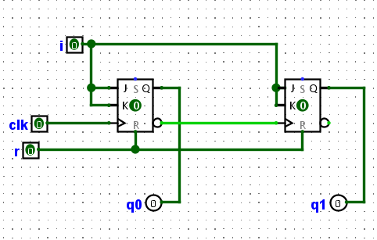
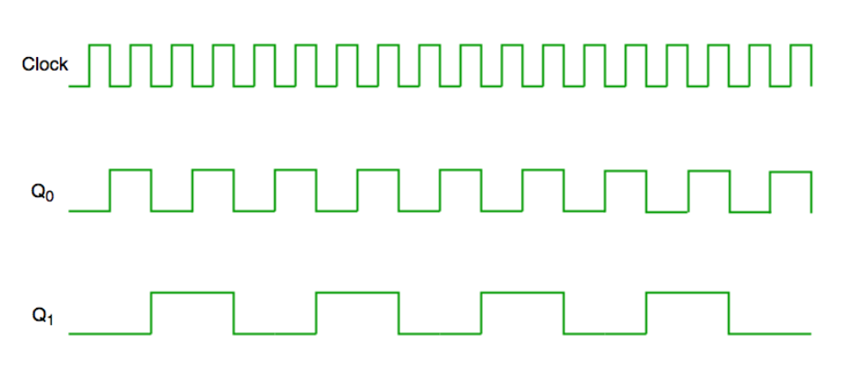
j-k Async

Slide 10
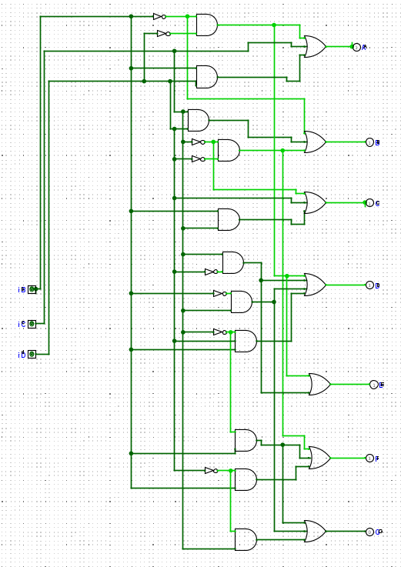
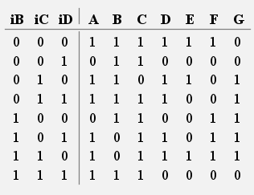
7 segment

Slide 11
Our values
1
Leadership
2
Teamwork
3
Creativity

Slide 12
Thank you!

